Slide 1
EE499 Concept Session #1
Dr. Ehab Ashary

Slide 2
Problem Definition

Slide 3
Engineer vs. Scientist
Scientist
observe the world
very general
create questions
Engineer
work on the world
more specific
solve problem
Inventor

Slide 4
Characteristics of Problems
Awareness
Problems are problems only if you are aware of them
Do not confuse with solutions
Wrong definition
Problems later
Limited choices in alternatives
Do not accept original problem statement
Customer’s definition?
e.g. home internet not working

Slide 5


Characteristics of Problems
Keep it simple
Sometimes, the solution is very simple but nobody saw it.
Problems are problems because they are not easily seen
Complex definition leads to complex solutions, missing simple solutions
A complex solution may indicate a poor problem definition

Slide 6
Collecting Background Information
Before you meet the customer
Collect information about the project topic
Familiarize with terminology used
Collect as much information as you can about customer need.
Write down notes (each member)
Meet as a team to form a more mature common understanding

Slide 7
Collecting Background Information
Meet the customer
Take notes
Concentrate on the technical problem
Understand things sept by step
Be a good listener. Understand then ask questions.
Identify what you miss from the big picture and ask
Do not flood the customer with questions.
Do not discuss your differences
Ask questions to the right expert (if there are several customer representatives)
Listen to the answers carefully and paraphrase your question if necessary.
If any ambiguities left, consult advisor.

Slide 8
Background Information

Slide 9
What is Considered Background
Background includes any information needed by an engineer with limited or no idea about your project topic:
To understand the terminology used in the project
To be familiar with the issues and circumstances around the project
To be convinced of the need and problem
To understand the physis needed to understand the topic
To understand customer needs any physics and engineering fundamentals needed to understand the general design and possible solutions
Any relevant detail needed to make logical flow of information.

Slide 10
Sources of Information
Books
High impact factor journal papers
Conference papers
Websites(Be Careful! not very reliable in general)

Slide 11
Writing the Background
Collect the information
Use reliable sources
Technical writing fundamentals
Organize the information in a very logical flow
Start with the generals, then go to specifics
Introduce anything before you talk about it
Do not go back and forth
Do not repeat information unless it is absolutely necessary
Do not assume that the reader know what you are talking about
Have the reader in mind
No plagiarism
Paraphrase

Slide 12
What is Considered Background
Should be like a story to tell (warning!)
Include only what is appropriate.

Slide 13
What is not Considered Background
Customer needs
Objectives of the project
Attempts to define the problem
Solution suggestions
Technologies and past designs related to topic
Any redundant detail you just copy and paste from the web to fill space.

Slide 14
Literature Review

Slide 15
Literature Review
A literature review is an objective, critical summary of published research literature relevant to the topic under consideration.
Its objective is to know what other people have done in the project topic and what solutions have been proposed for the problem at hand and related problems.
It serves the following purposes
Avoid repeating other people failures
More insight into the problem and possible solutions
Start form where people have ended
Supplement you background information

Slide 16
Project Objectives and Specifications

Slide 17
Project Objectives
Higher-level (Strategic) Objectives
Global
Long-term
Economical, societal, environmental, welfare, safey
Lower-level objectives
Local
Short-term
Technical
Must be related to the problem to be solved.

Slide 18
Project Design Specifications (PDS)
A set of design requirements
Specifications are quantitative, measurable criteria that the product or service is designed to satisfy.
A specification serves as the basis for determining the features of the product.
May include key performance indicators (KPI) to monitor project progress.

Slide 19
Project Design Specifications (PDS)
Define requirements in terms of inputs, outputs, throughput, data flow, and behavior of the system.
For each requirement, the team must develop a test to verify that the product meets the requirement.
Design specifications include
Explicit customer requirements Design Constraints
When developing PDS, the designers must identify
Assumptions

Slide 20
Project Design Specifications (PDS)
Well-defined specs ensure that
Designers know exactly what to develop
Team knows what to test
Stakeholders know exactly what they will receive

Slide 21
Criteria for Good Requirements
Necessary
If a system can meet the intended use without the requirement, it is not necessary
Feasible
Can be accomplished within budget and time frame
Concise
Unambiguous
Correct
Complete
All conditions under which the requirement applies are stated

Slide 22
Criteria for a Good Requirement
Consistent
Does not conflict with other requirements
Verifiable
Implementation can be proved
Design Independent
Does not impose a specific implementation solution
Non-redundant
Not a duplicate (not even partial) of another requirement
No escape clauses
No if, when, except, unless, although, usually, generally, often, normally, typically, etc.

Slide 23
Design Constraints

Slide 24

What is a constraint?
A constraint is any design requirement that are imposed on the project and explicitly required by the customer.
Usually, not imposed by the functionality of the product itself
Constraints may be imposed by
Hardware or software environment
End-user environment
Standards, Laws
Environmental requirements
Interoperability requirements
Interface requirements
Security, safety
Verification and validation requirements
etc.

Slide 25



Product Design Constraints and Requirements
Design Engineers must consider a multitude of technical, economic, social, environmental, and political constraints when they design products and processes.
There must be clear evidence in your design project that you have addressed the constraints that are relevant to your project.

Slide 26
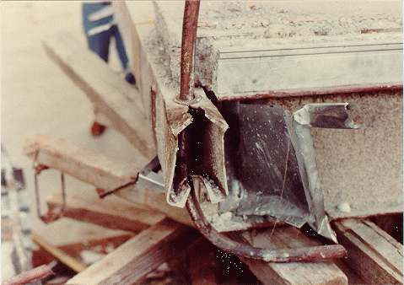
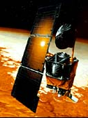
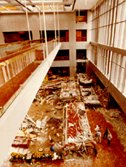
Functional Constraints
Overall Geometry – size, width, space, arrangement
Motion of parts – type, direction, velocities, acceleration, kinematics
Forces involved – load direction, magnitude, load, impact
Energy needed – heating, cooling, conversion, pressure
Materials to be used – flow, transport, properties
Control system – electrical, hydraulic, mechanical, pneumatic
Information flow – inputs, outputs, form, display

Slide 27


Safety Constraints
Operational – direct, indirect, hazard elimination
Human – warnings, training
Environmental – land, sea, air, noise, light, radiation, reaction, transport

Slide 28
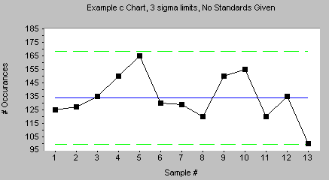


Quality Constraints
Quality assurance – regulations, standards, codes
Quality control – inspection, testing, labeling
Reliability – design life, failures, statistics

Slide 29
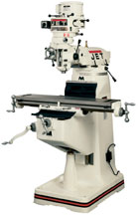
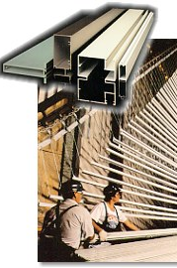
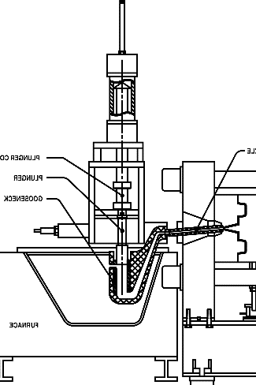
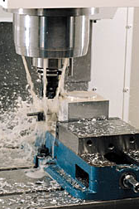
Manufacturing Constraints
Production of components – factory limitations, means of production, wastes
Purchase of components – supplier quality, reliability, quality control, inspection
Assembly – installation, foundations, bolting, welding
Transport – material handling, clearance, packaging

Slide 30
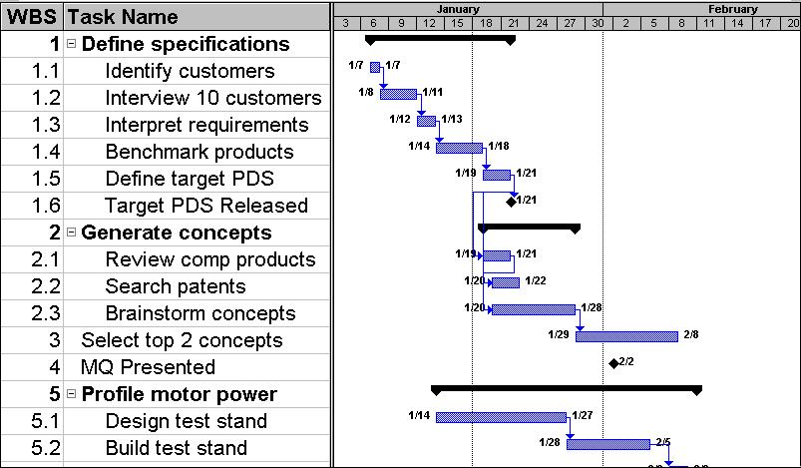
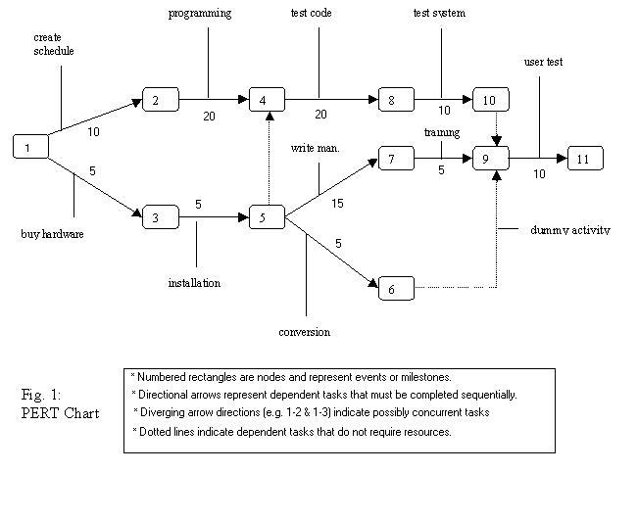
Timing Constraints
Design schedule – project planning, project control
Development schedule – design detailing, compliance tests
Production schedule – manufacture, assembly, packing, transport
Delivery schedule – delivery date, distribution network, supply chains

Slide 31

Economic Constraints
Marketing analysis – size of market, distribution, market segments
Design costs – design team computing, information retrieval
Development costs – design detailing, supplier costs, testing costs
Manufacturing cost - tooling, labor, overhead, assembly, inspection
Distribution costs - packing, transport, service centers, spare parts, warranty
Resources – time, budget, labor, capital, machines, material
$

Slide 32




Ergonomic Constraints
User needs – type of operation, instructions, warnings
Ergonomic design – man-machine relationships, operation, height, layout, comfort, lighting
Cybernetic design – controls, layout, clarity, interactions

Slide 33
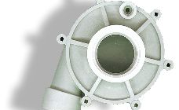

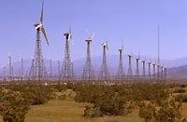
Ecological Constraints
General environmental impact – impact on natural resources, social resources
Sustainability – political and commercial consequences, implications for following generations
Material selection –solid, liquid, gas, stability, protection, toxicity
Working fluid selection – fluid, gas, flammability, toxicity

Slide 34




Aesthetic Constraints
Customer appeal – shape, color, texture, form, feel, smell, surprise and delight features
Fashion – culture, history, trends
Future expectations – rate of change in technology, trends, product families

Slide 35
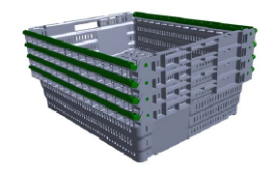
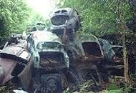

Life-Cycle Constraints
Distribution – means of transport, nature and conditions of dispatch, rules, regulations
Operation – quietness, wear, special uses, working environments
Maintenance – servicing intervals, inspection, exchange and repair, cleaning, diagnostics
Disposal – recycle, scrap

Slide 36




Legal/Ethical Constraints
Regulations – OSHA, FAA, FDA
Ethics – public safety, health, welfare and integrity
Intellectual Property – patents, trademarks, copyrights

Slide 37
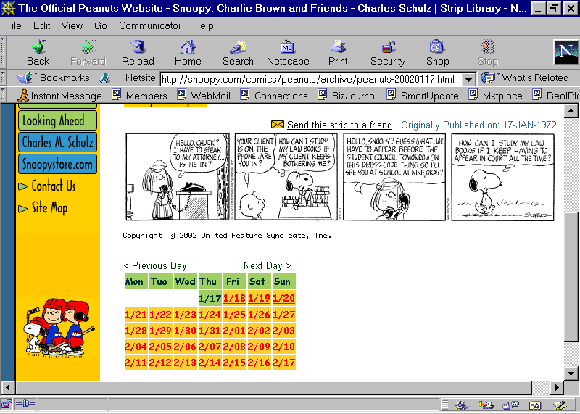
Summary
Think about CONSTRAINTS
Plan for them
Put them into the design

Slide 38
Assumptions

Slide 39
Assumptions
Assumptions are made about conditions required for the product to work, e.g.
Internet access exists.
The area in which the product will be used has mobile network coverage.
Site has electricity.
They are usually expected to hold. However, they must be made explicitly in the PDS.
They are usually separately from the customer’s requirements.
Think of anything that is required for the product to work and, unless it is listed in the requirements, add it as an assumption.

Slide 40
Types of Standards
Technical Standards: Detailed specifications intended to be used consistently as a rule, guideline, or definition. Examples include ISO standards for quality management, IEEE standards for electrical engineering, and W3C standards for web development.
Test Method.
Safety Standards: Created to ensure the safety of products, activities, or environments
Healthcare Standards: Guidelines and practices for healthcare providers to ensure quality and safety in patient care.

Slide 41
Why Do We Have Standards?
Safety
Uniformity/Consistency
Efficiency
Commerce and Trade

Slide 42
Project Design Specifications (PDS)
Provides information about
Objectives
Scope
Constraints
Assumptions
Deliverables

